Slide 1
Morgan O’Dell

Slide 2
Standard:
SCSh7. Students analyze how scientific knowledge is developed.;
Assignment:
Students will demonstrate their knowledge of the scientific method using the app and online journal, Seesaw, by designing their own experiment and recording their results.
This project will be done through a 3 day period and will have the criteria displayed on a PowerPoint for each day’s activity.

Slide 3
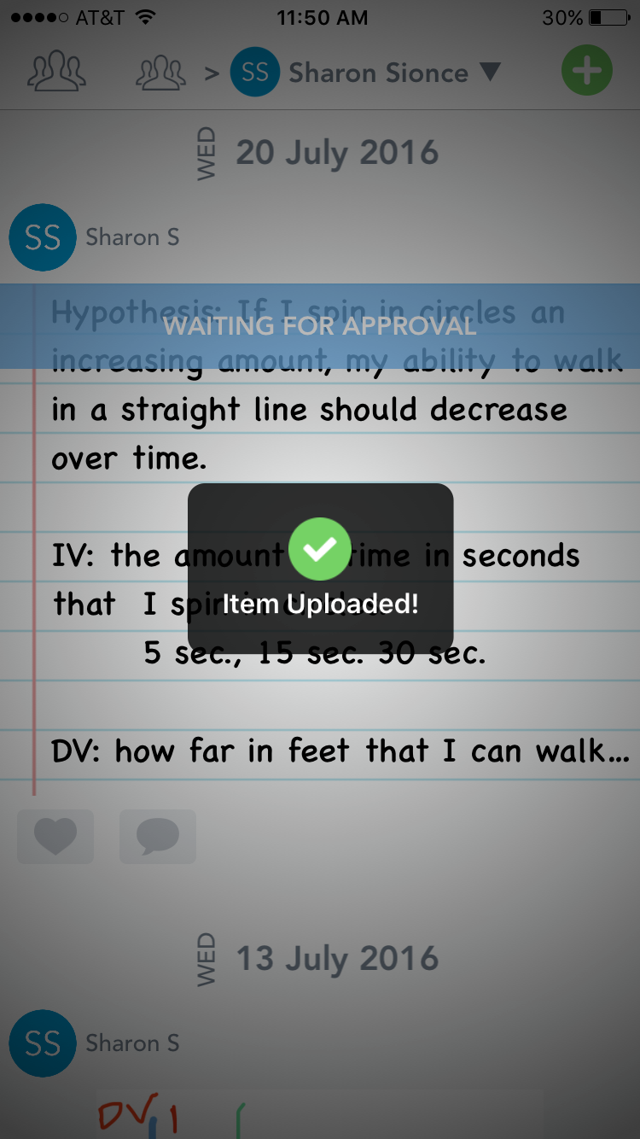
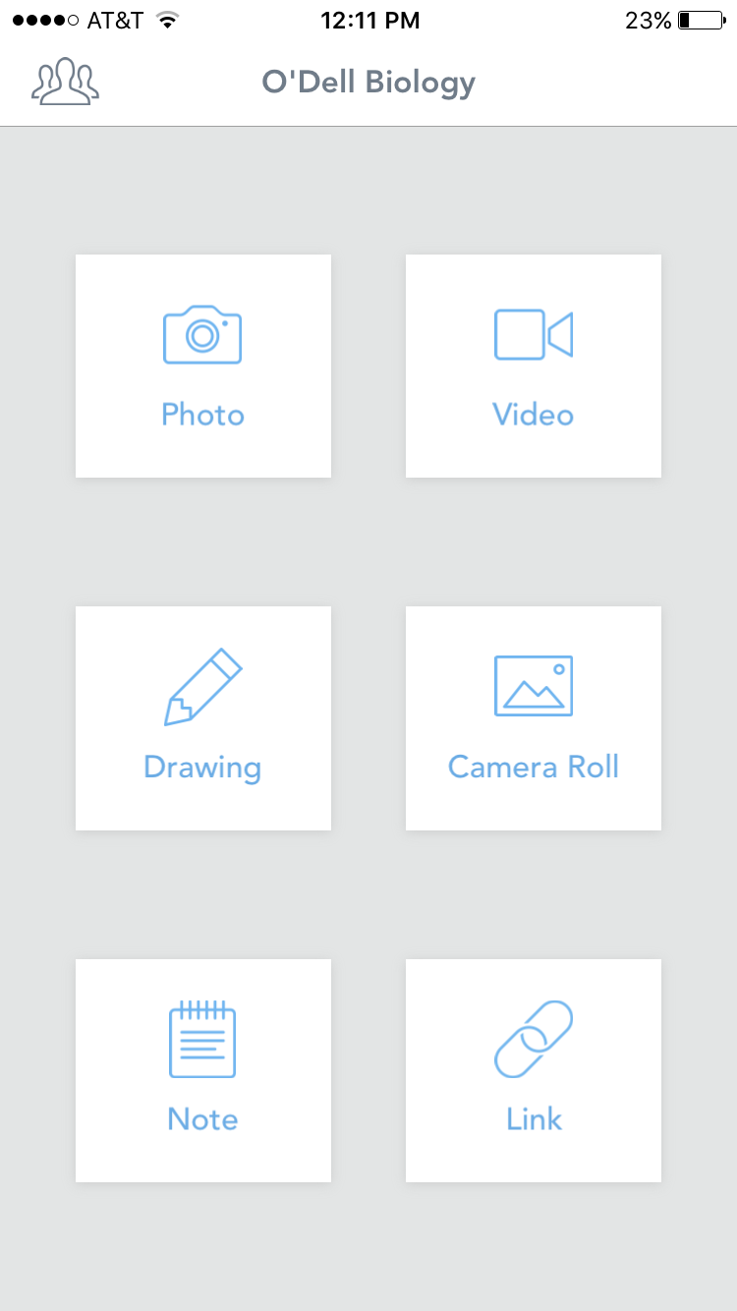
Tool & Resources:
Seesaw is an interactive journal for students!
Here’s a quick look at the student’s view>>>
Let’s check out this LINK to learn more!

Slide 4
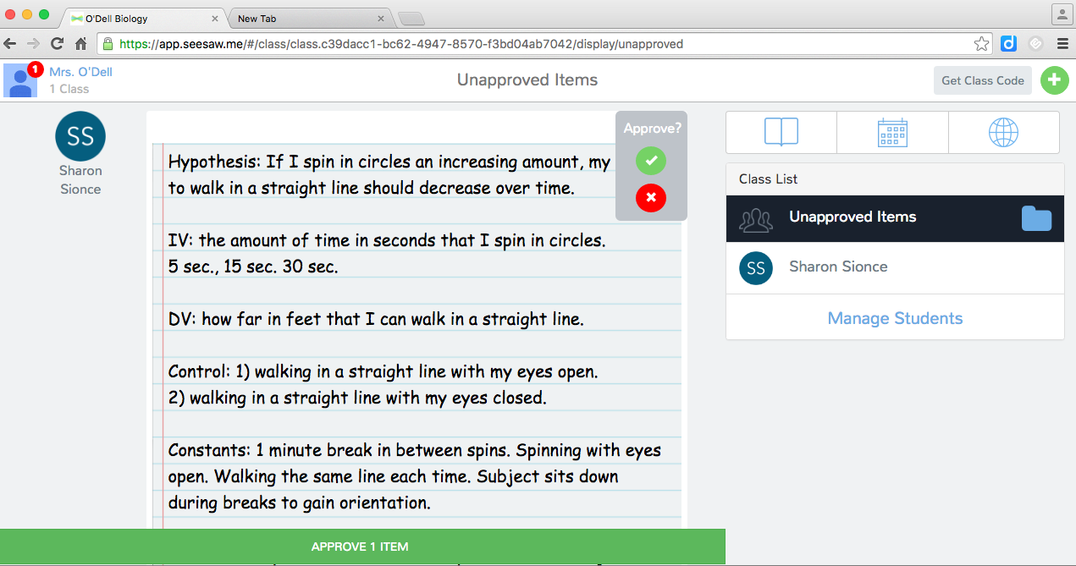
Student Sample for Part 1

Slide 5
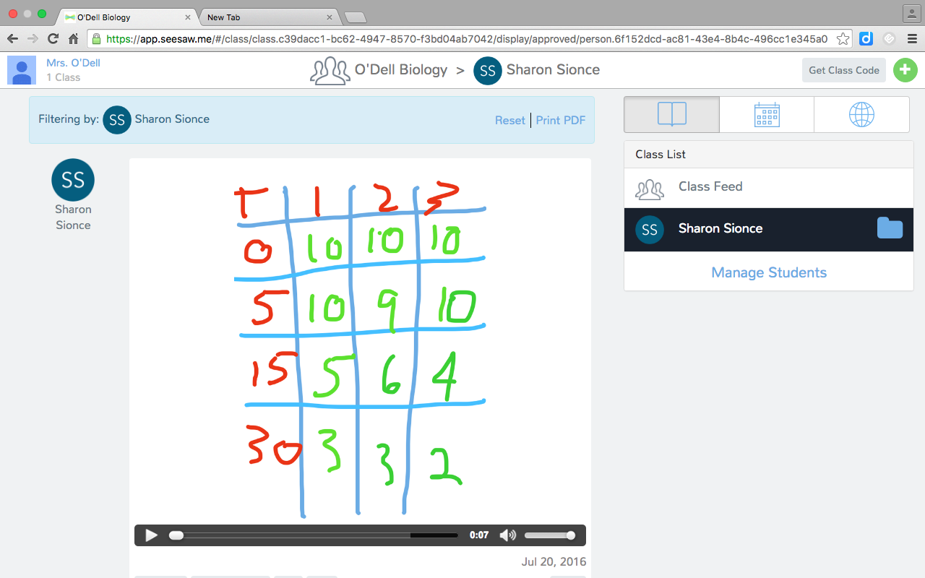
Student Sample for Part 2
Students can also do videos!

Slide 6
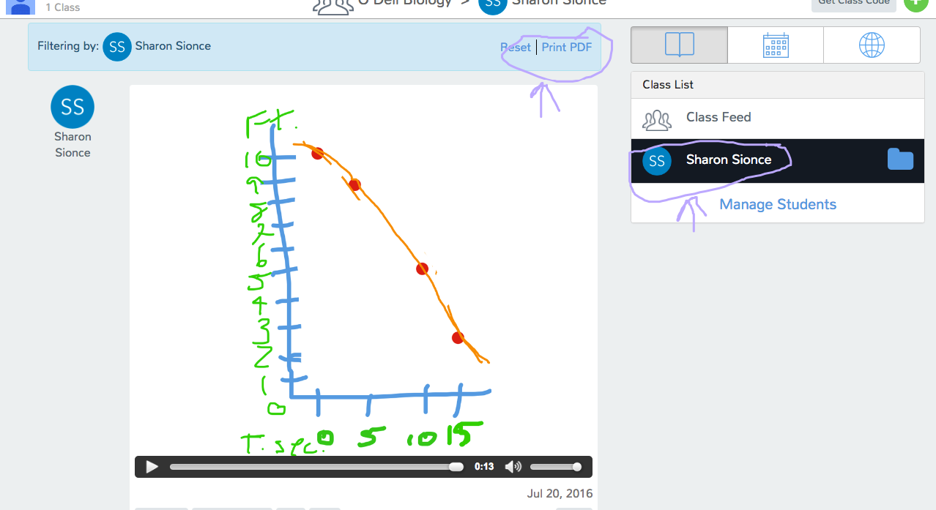
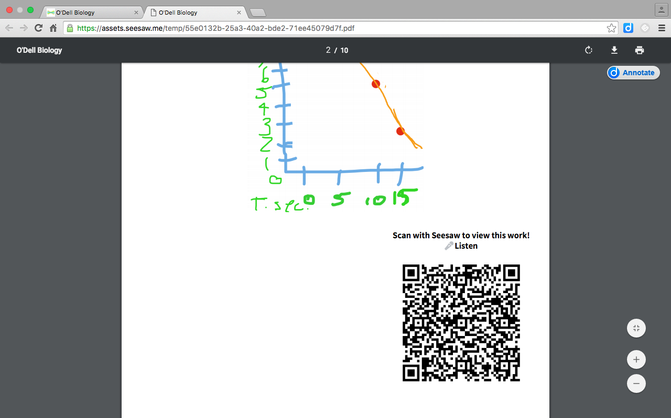
Student Sample for Part 3
Teachers can choose to browse by student or make a PDF portfolio of students’ work!

